Slide 1
The Cognitive Abilities Profile (CAP) 30min Introduction
Aim:
How to use the CAP in consultations and observations
Sam Simmonds adapted from Ruth Deutsch
Notes:
1
Is there any
How to use the CAP to plan interventions and review progress
Consultation only – filling in sections A-C
Consultation only – filling in sections A-C
Or
Observation filling in section B, then consulation filling in A-C.
Can start at any section.
Or
Observation filling in section B, then consulation filling in A-C.
Can start at any section.
thing else anyone wants to achieve in this session?

Slide 2
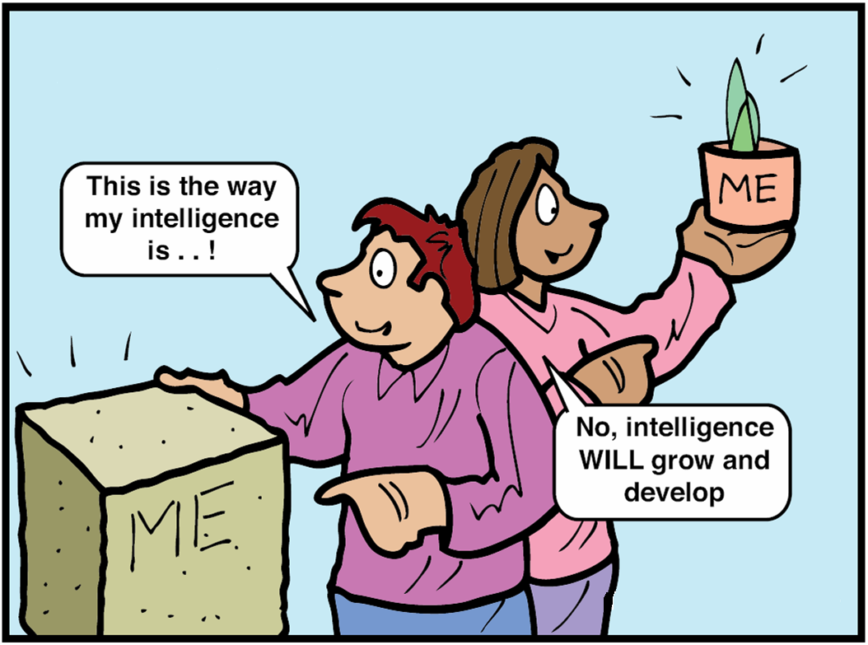

What is it? Why use it?
Consultation
Observation
Used from foundation
stage to KS4 and special schools
Based on principles of dynamic assessment, solution focused psychology and collaborative working.
Notes:
What do people already know about the CAP?
When to use
To gain an understanding of the child's cognitive abilities, …………
Unable/not appropriate/no time to do an assessment with the child.
To get school and parents working together
EHCPs – it is collaborative and gives holistic information about the child in a short space of time.
Collaborative
Solution focused
Creates thinking skills profile
Strategies and recommendations
Based on principles of dynamic assessment
Empowering
Processes of learning (rather than productsConsultation and observation tool
Framework for a collaborative process
Based on principles of dynamic assessment – focusing on tomorrows learning
Consultation approach normally with school and family
Link to intervention and what makes a difference
Follow-up and review
A profile of the learner’s thinking skills
Information about the processes of learning (rather than products)
Conditions required for successful learning
The amount and type of support (mediation)

Slide 3
Components of the CAP
Consumables
1 Record Form
1 Summary Profile and Intervention Plan
Manual including
Instructions and guidelines- chp3-5
Interpretation
Strategies for Intervention – chp8
Case Studies
Research and Development

Slide 4
A Tripartite Learning Partnership
Task
Mediator analyses task
Task determines mediation
Learner brings cog. fn. to task
Task requires cog fn. of learner
© Copyright: Ruth M Deutsch
Learner
Mediator
Mediator analyses learner’s potential
Learner requires mediation

Slide 5
CAP has 3 sections:
Record from:
Section A: The Cognitive Abilities of the Learner – Consultation (and observation)
Section B: Response to Teaching and Mediation – observation (and/or consultation)
Section C: Task Analysis – observation
Summary form:
Summary Profile
Intervention Plan
Review Profiles
Notes:
4 sections can be used in various combinations
All three components need to be addressed within and across different learning situations and activities

Slide 6
Section A
Cognitive abilities of the leaner
Done as a consultation (observation before ideal but not necessary)
Notes:
Very similar to PIP – SECTION A

Slide 7
Section A: Cognitive Abilities
Chapter 3: The 7 functional domains are
Attention – pg28
Perception -
Memory –
Language and Communication
Reasoning/Logic
Strategic Thinking/Metacognition
Behaviours Affecting Learning
Notes:
The cog abilities are in this order, since the abilities at the top are likely to have an impact on the skills going down respectively.
i.e. a low score for attention might lead to a low score in everything else, therefore the area to focus the intervention on will be attention.

Slide 8
Section A Scoring
Ideally agree a score or middle value between people.
Scoring a section - add up the scores and divide by how many there are (don’t include N scores).
Scoring Key
N | Not observed/ Not applicable
1 | Not able even with support
2 | Only able with support
3 | Sometimes able/inconsistent
4 | Independently able
 | ½ points if cant decided
Notes:
Slightly different meaning for each Section A-C

Slide 9
Optional further analyses pg8
Modality Preference
Visual, auditory and/or kinaesthetic preference
Phase Analysis
Input (gathering and taking in information)
Elaboration (processing and thinking about the information gathered, transforming it in some way)
Output (giving a response or answer to the task or problem)
Notes:
test
page 9 test

Slide 10
Summary form
Graph - Hand draw or spread sheet to create one for reports.
Strength
Difficulty
Intervention plan 3 areas.

Slide 12
Section B
The learner’s response to teaching & mediation
Done as an observation and then consultation (although can be done without an observation)

Slide 13
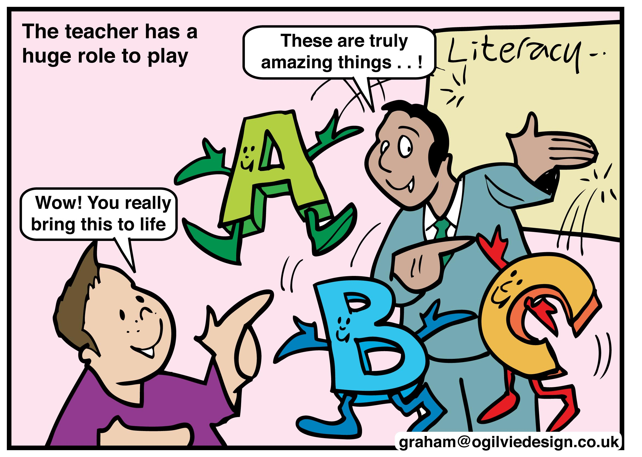
Section B: Response to Teaching and Mediation
Chapter 4
Score reflects level of learner’s response to a variety of teaching strategies
Use of the solution focused approach
Scoring rules the same but statements slightly different.
Notes:
Develops insights into:
Reasons for success and failure
Reasons for choice of strategy
What works for me?
Individual cognitive styles and preferences
Metacognitive and meta-memory strategies
Definition of the goals of the problem

Slide 14
Summary Form
Strategies the learner most responded to?
Strategies the learner least responded to?

Slide 15
Section C
Observation (then consultation or could be done just consultation)
Task analysis (not learner)
It can be used to adapt learning tasks to differentiate the curriculum.
Notes:
It can be used to differentiate more specifically (not just repeating work from earlier years)
It can be used for Curriculum Based Dynamic Assessment (CBDA)

Slide 16
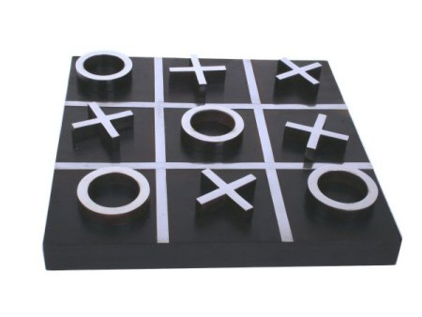
Task analysis - Noughts and Crosses
C6
In a pair
Pick two aspects of Noughts and Crosses to ‘analysis’
Using the record form and manual
Notes:
How could this be used to help differentiate (intervention planning)?

Slide 17
Summary form
Tasks that lead to success
Tasks that present challenge

Slide 18
Summary Profile
Intervention Plan

Slide 19
Intervention Plan (IP)
The IP includes:
Target areas for intervention from Section A (priority difficulties)
Target CAP scores (+ 0.5 or 1)
Strategies and task aspects from Sections B and C
Also can use the strategies for intervention section of guidance manual (Chapter 8)

Slide 20
Review/Follow-up
Set a time to review the IP
Re-score the areas for intervention
Were the strategies helpful / effective?
Choose whether to:
Set a new target in the same area or
Re-profile and find new priority areas for intervention

Slide 21
Baseline and Review: purple, 2010. green, 2011

Slide 22
Contact information
The CAP website is available via
www. Realtraining.co.uk or
www. Dynamicassessment.co.uk
For CAP supplies; requests for courses and general information, call Real Training
(0)1273 35 80 80

Slide 23
Evaluation – post-its
WWW
EBI
Notes:
What have you learned?
What would you like to try?
What are you pleased about?
What are you concerned about?
What will you do next? (Individual/ group/ service)

